Slide 1
Quiz Mania
Play and learn

Slide 2
Introduction:
In “QUIZ MANIA” you can generate and manage a simple database for questions. The question number is automatically generated by the software and is stored in a file by the name 'QUESTION'. In this software the Question will be asked to the user & the user get 10 sec for answering the question. If the user is correct then he get 10 points on every question. If he is incorrect he loses 2 points.
This project is developed considering “QUIZ” information keeping context of the customer in mind.

Slide 3
Description:
The first page will be a login page where the user will login as Admin or Test taker.
The administrator will have the options to add the question to the database, add or delete the test takers login Id and Password from the database.
The test taker after the login page will be prompted to select the topic on which he/she wants to take the quiz.
At the end of the quiz a detailed score card will be displayed.

Slide 4
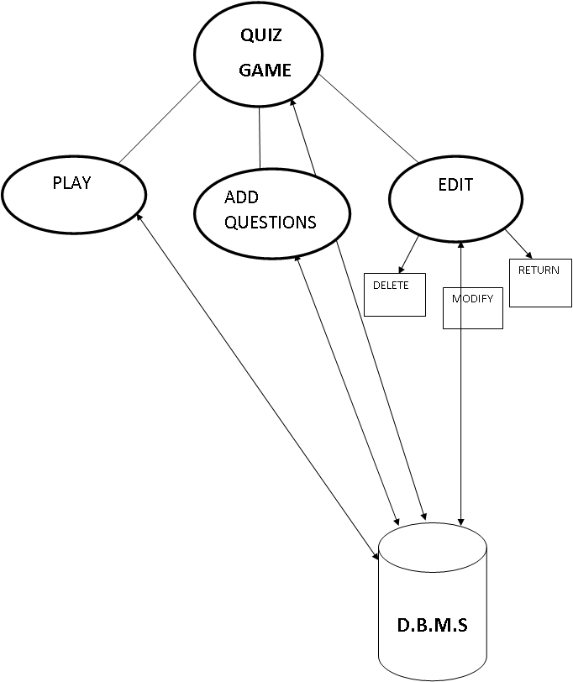

Slide 5
Specific Requirements
1.7 GHz Pentium IV
256 MB RAM
A Hard-drive space for storing questions.
Operating System: Any Windows Platform
C++
File Handling

Slide 6
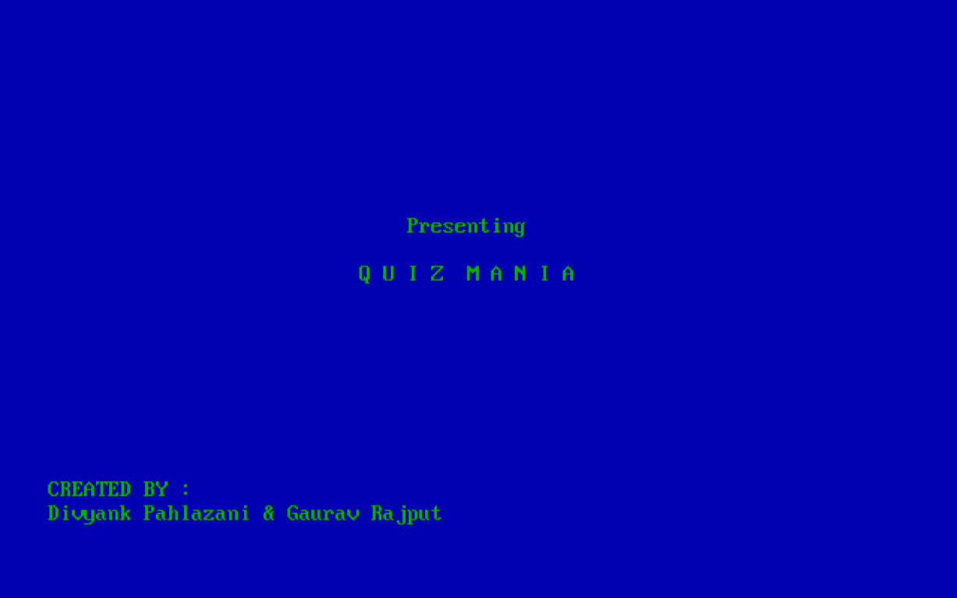

Slide 7
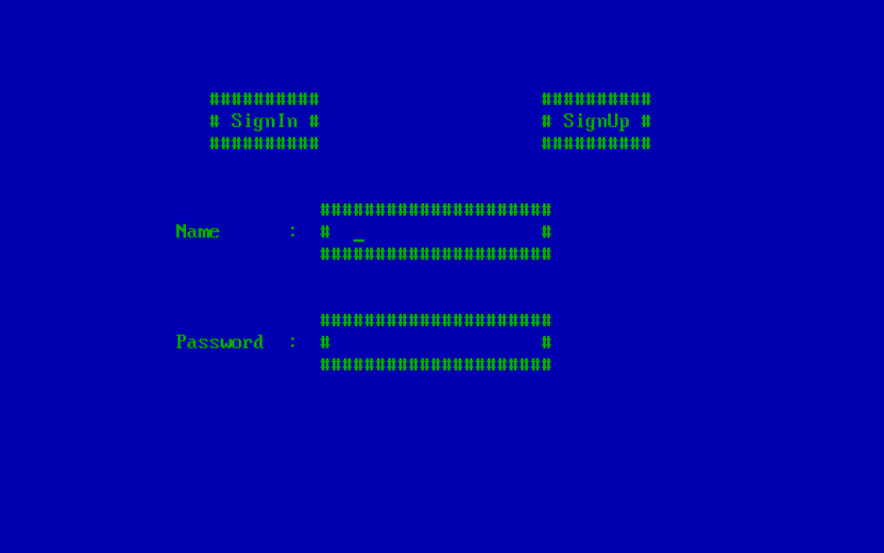

Slide 8


Slide 9


Slide 10
CONCLUSION:
The Quiz Game is capable to handle number of Question record having all their information stored in the backend file.

